Slide 1
Norm of a Vector
Let v(f) be IPS
α belongs to v(f)
What is α?
α is a vector
Then define norm
|| α||=sqrt(α, α)
Let α=(1,2,1)
|| α||=(1*1+2*2+1*1)=6

Slide 2
UNIT VECTOR IN IPS
Any vector in V(f) is called as unit vector
If it norms is 1
Or
i.e. any α belongs to v(f) is unit vector if
|| α||=1
What is the formula for unit vector ?
α/|| α||

Slide 3
Let we prove
(α/|| α||, α/|| α||)=1
1/|| α||(α,1/ || α||)
1/|| α||2(α, α)
=1

Slide 4
changing the basis
In linear algebra, changing the basis is a fundamental concept that arises when working with vector spaces.
A basis for a vector space is a set of vectors that spans the space and is linearly independent. Changing the basis means expressing vectors in terms of a different set of basis vectors.
Let's say you have a vector space V with a basis {v₁, v₂, ..., vₙ}. If you want to express a vector v in terms of a different basis {u₁, u₂, ..., uₙ}, you need to find the coordinates or coefficients of v with respect to the new basis.
Let's denote the original basis as B = {v₁, v₂, ..., vₙ} and the new basis as C = {u₁, u₂, ..., uₙ}. If v can be expressed as a linear combination of the original basis vectors:

Slide 5
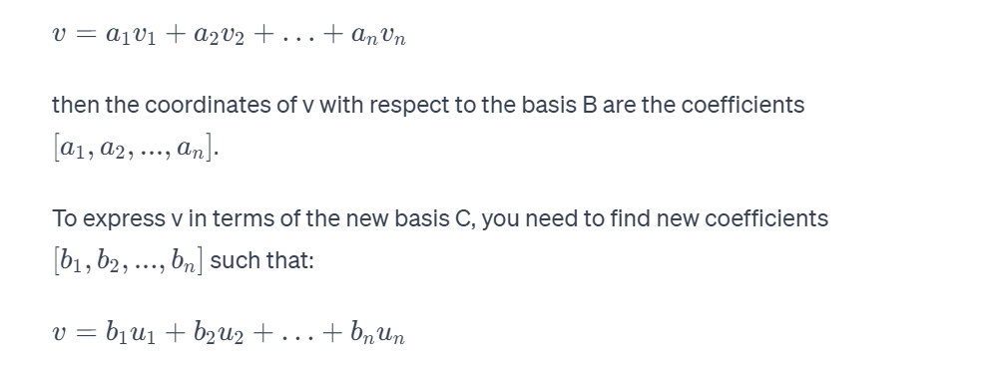
changing the basis

Slide 6
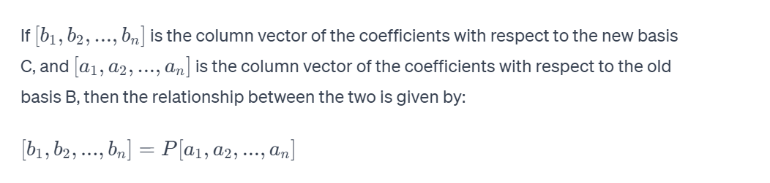
changing the basis
The change of basis matrix, denoted as P, is a matrix whose columns are the vectors of the new basis expressed in terms of the old basis.
The matrix P allows you to transform coordinates from the old basis to the new basis.
changing the basis involves finding the change of basis matrix P, and then using it to transform the coordinates of vectors between the old and new bases.

Slide 7
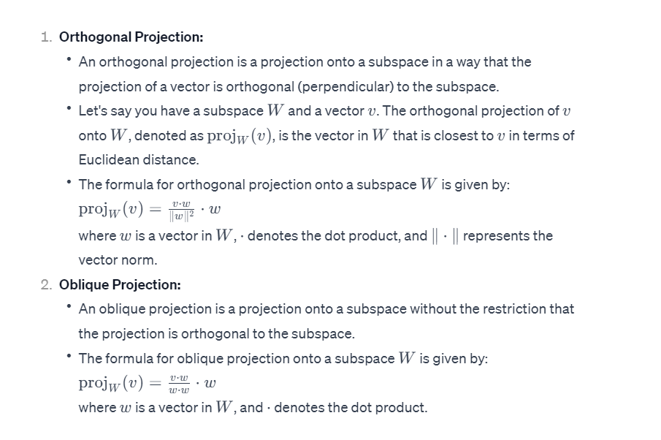
Projection
In linear algebra, a projection is a linear transformation that maps a vector onto a subspace, typically in a way that preserves certain geometric properties. When one projects a vector, say v, onto a subspace, you find the vector in the subspace which is "closest" to v. There are two common types of projections: orthogonal projection and oblique projection.

Slide 8
Solving a Pair of Simultaneous Equations Using Matrices
Express the given simultaneous equations as a matrix equation.
Write down the inverse of the coefficient matrix.
Multiply through by the inverse, on the left-hand side, to solve the matrix equation.

Slide 9
Transformation Matrix
Transformation Matrix is a matrix that transforms one vector into another vector by the process of matrix multiplication.
The transformation matrix transforms a vector into another vector, which can be understood geometrically in a two-dimensional or a three-dimensional space.
The frequently used transformations are stretching, squeezing, rotation, reflection, and orthogonal projection.

Slide 10
Stretching-: The linear transformation enlarges the distance in the xy plane by a constant value. Here the distance is enlarged or compressed in a particular direction with reference to only one of the axis and the other axis is kept constant.
Rotation-: The transformation matrix helps to rotate the vector in an anticlockwise direction at an angle θ.
Shearing-:The shearing changes the vector in such a way that the square boxes in the coordinate axes are deformed into parallelograms.

Slide 11
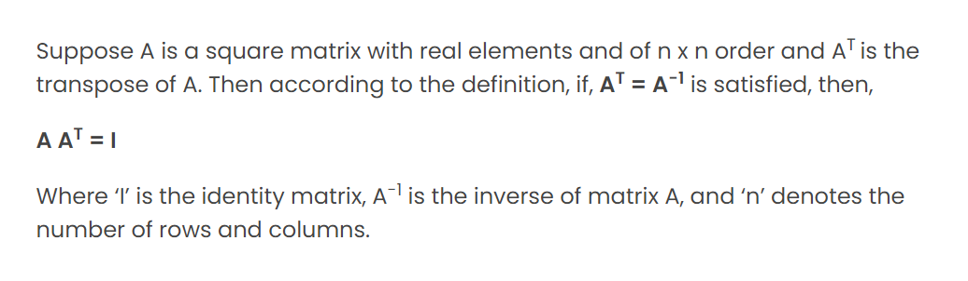
Orthogonal Matrix
A square matrix with elements are said to be an orthogonal matrix if its transpose is equal to its inverse matrix.
we can say when the product of a square matrix and its transpose gives an identity matrix, then the square matrix is known as an orthogonal matrix.

Slide 12
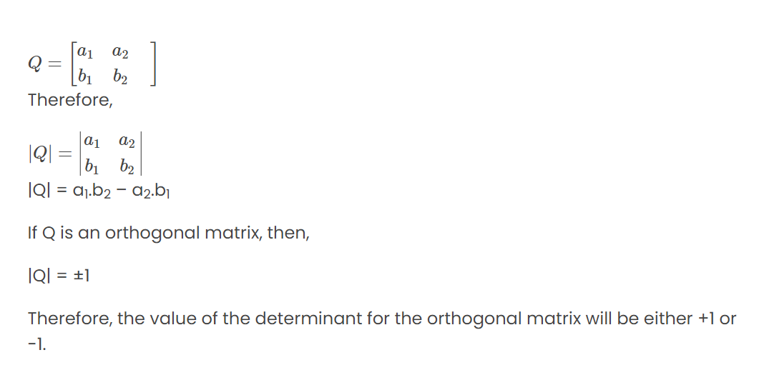
Determinant of Orthogonal Matrix
The number which is associated with the matrix is the determinant of a matrix. The determinant of a square matrix is represented inside vertical bars. Let Q be a square matrix having elements and P is the determinant, then,

Slide 13
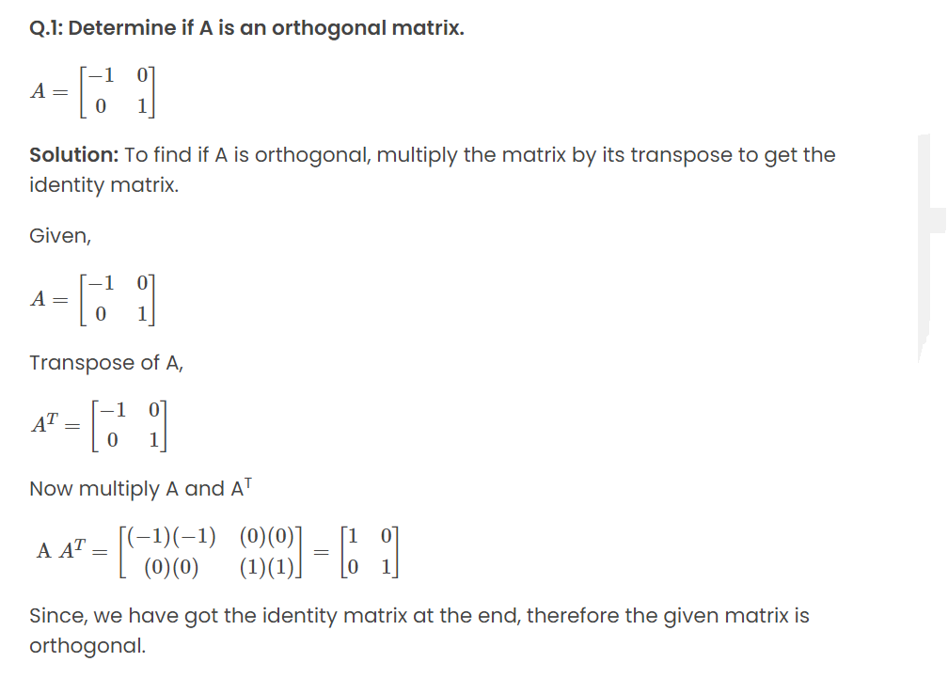
Orthogonal Matrix

